Slide 1

CHANGES IN THE WORLD AROUND US
CLASS – VII

Slide 2
CLASSIFICATION OF CHANGES
1.Natural change
2.Man-made change
3.Periodic and Non periodic change
4.Desirable and Undesirable change
5.Fast and slow change
6.Reversible and Irreversible change
7.Physical and Chemical change
8.Energy change

Slide 3
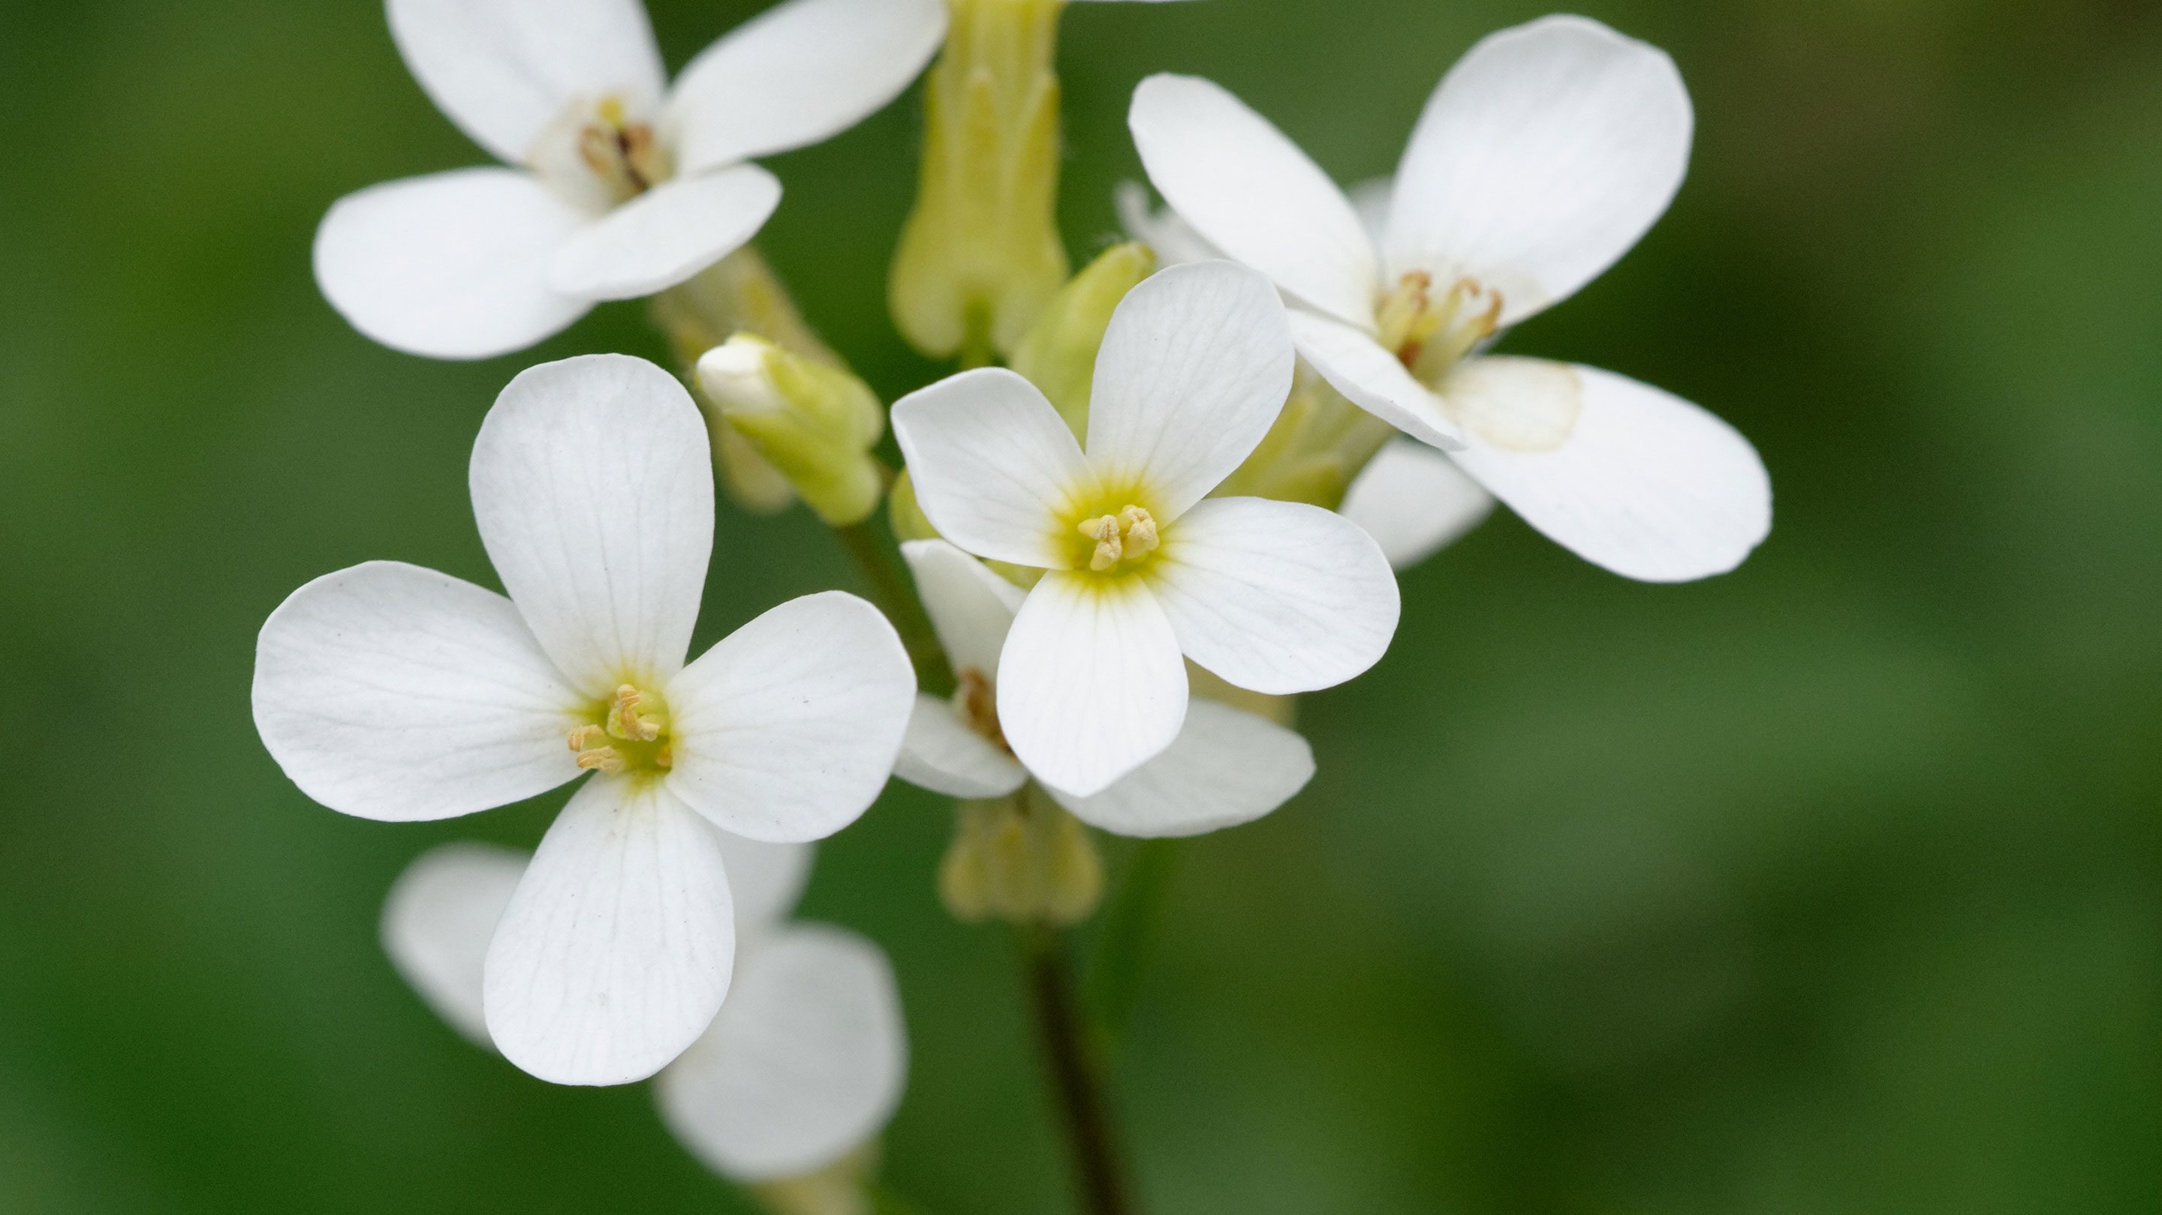
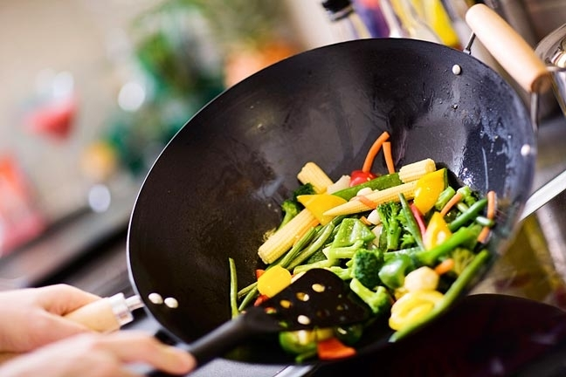
NATURAL CHANGE AND MAN-MADE CHANGE
1.NATURAL CHANGE
Changes that takes place by nature
Examples-ripening of fruits, change in weather etc
2.MAN-MADE CHANGES
Changes that takes place due to activities of man.
Examples-burning of fuels,cooking of food etc

Slide 4

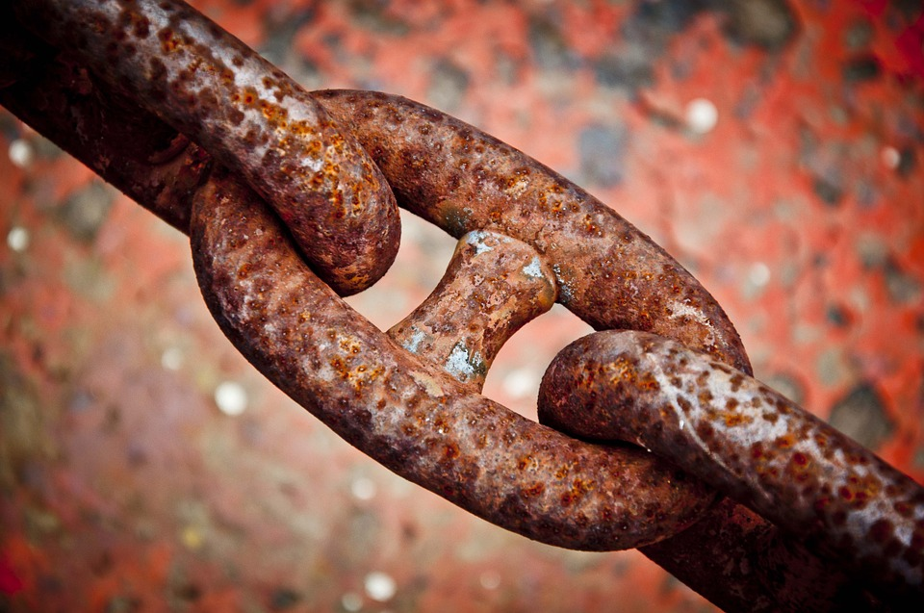


PERIODIC AND NON PERIODIC CHANGE,DESIRABLE AND UNDESIRABLE CHANGE
3.PERIODIC CHANGE-
That occur after fixed interval of time.
Examples-change of seasons, formation of day and night etc.
NON-PERIODIC CHANGE-
That may occur at anytime
Examples-rusting of iron, breaking of glass.
4.DESIRABLE CHANGE-
That are useful to us.
examples-ripening of fruits, drying of cloths.
UNDESIRABLE CHANGE-
Changes that are harmful to us.
examples-spoiling of food, breaking of glass.

Slide 5
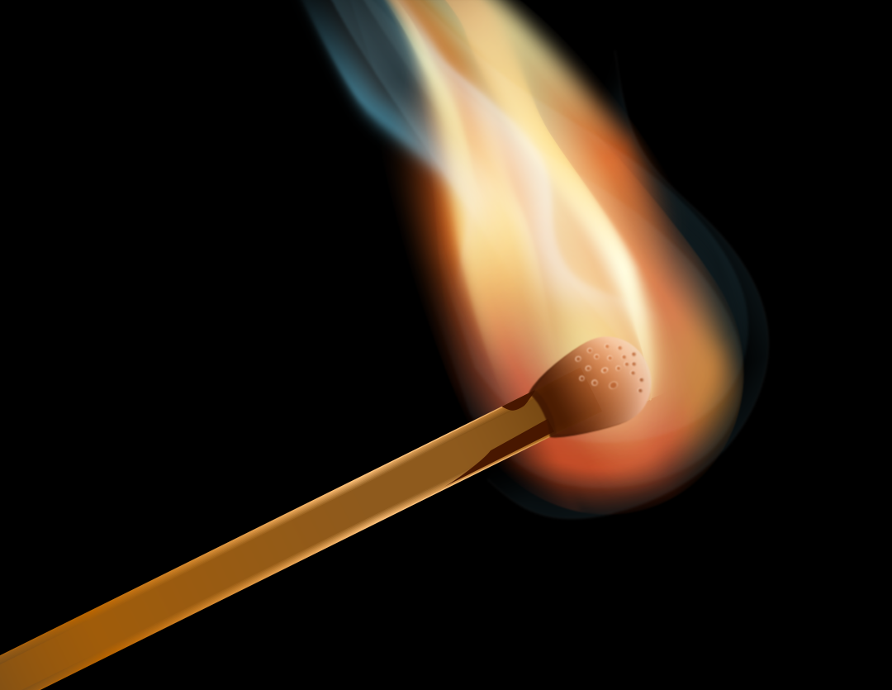
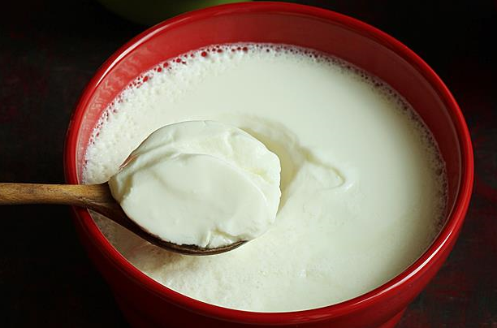
FAST AND SLOW CHANGE
Fast changes- that occur in a very short duration of time examples- burning of paper,burning of matchstick etc
Slow changes-that take longer duration of time for their completion.
Examples-formation of curd, rusting of iron etc

Slide 6
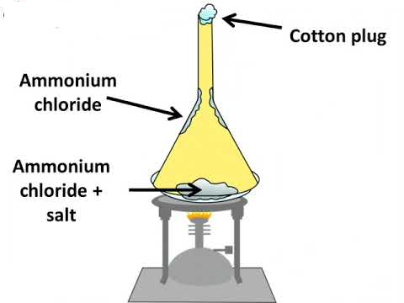
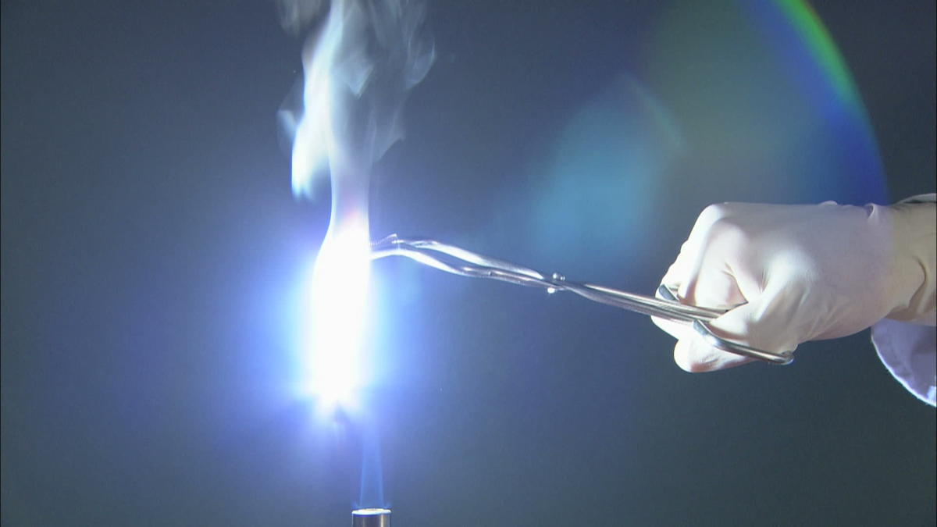
REVERSIBLE AND IRREVERSIBLE CHANGES
Reversible changes are changes which can be reversed by a change in conditions.
Examples: Melting of ice and freezing of water, sublimation of ammonium chloride.
Irreversible changes are changes which cannot be reversed by a change in conditions.
Example: Burning of magnesium.

Slide 7
PHYSICAL AND CHEMICAL CHANGE
PHYSICAL CHANGE-
The substance undergoing the change is not destroyed.
No new element or compound are formed
Only the colour shape or size of the substance may change.
CHEMICAL CHANGE-
New substances are formed
Properties of substances before and after the change are different.
Irreversible and permanent change.
EXAMPLES
Glowing of an electric bulb
Drying of cloths
Magnetisation of iron nail.
EXAMPLES
Burning of wood
Rusting of iron
Burning of magnesium
Souring of milk
Burning of a candle
Cooking of food

Slide 8
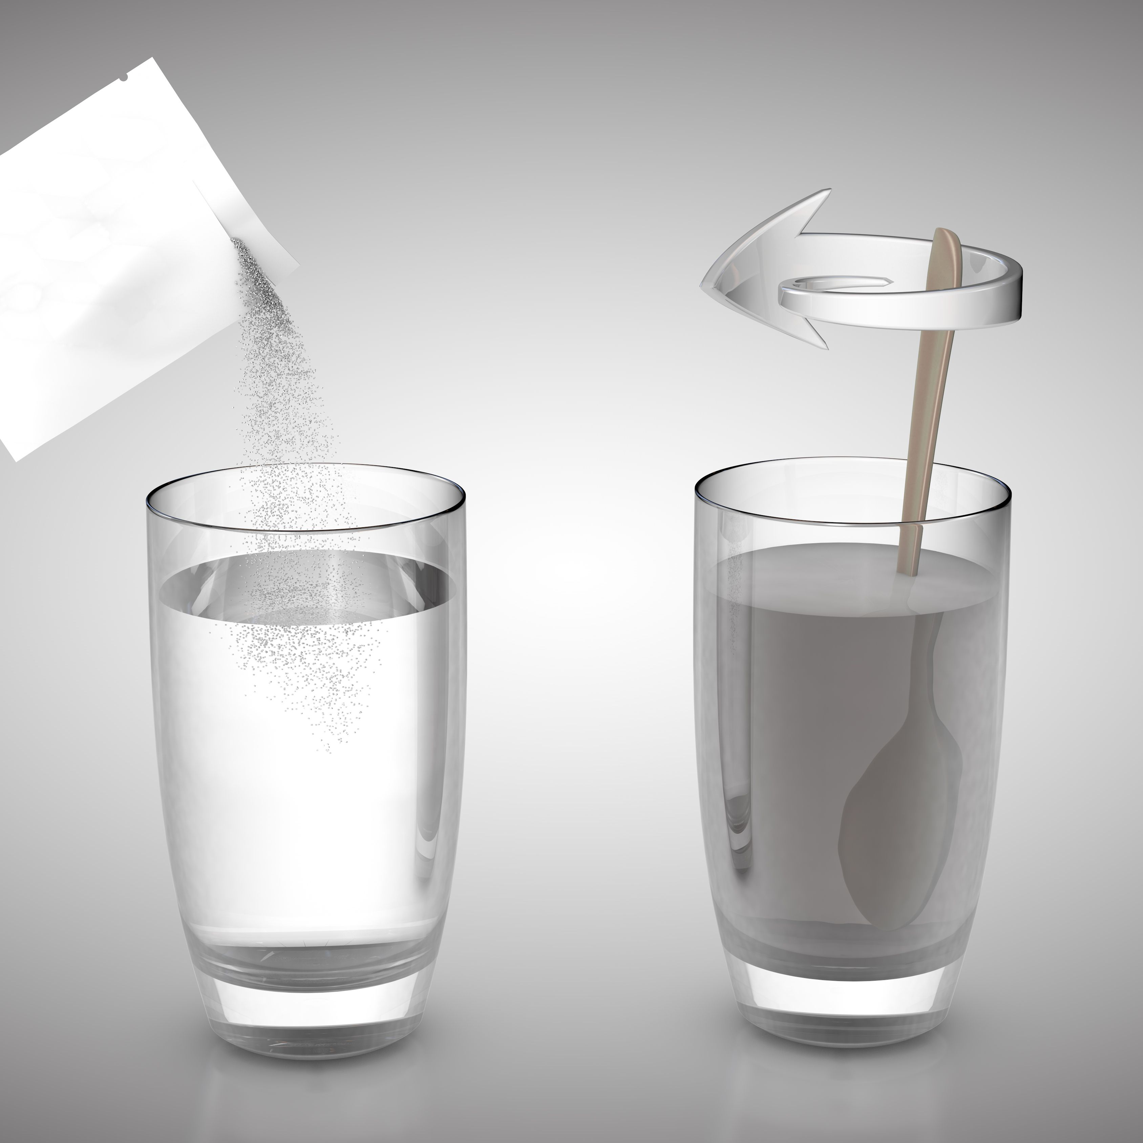
A change depends upon the nature and intensity of interaction
Take two tumblers.Fill them about half with water. Add one teaspoonful of sugar in each tumbler.
Stir the water in one tumbler with a spoon.
Keep the other tumbler undisturbed.
Observe carefully.
Observation
You will see that sugar dissolves rapidly in the glass tumbler in which the stirring was done.
It means that the nature of change depends upon the kind and extent of interaction.
Result
Thus more is the interaction,faster will be the change.

Slide 9
CHANGES INVOLVING ENERGY
ENDOTHERMIC CHANGE
Endo means ‘in’ and thermic means ‘heat’.
An endothermic change is the one in which the cooling is observed.
Example-if you put a small amount of glucose on your tongue,it dissolves and your tongue feels cool.
EXOTHERMIC CHANGE
The changes during which heat energy is evolved are known as exothermic reactions.(Exo means out and thermic means heat).
Example – cooking of food

Slide 10
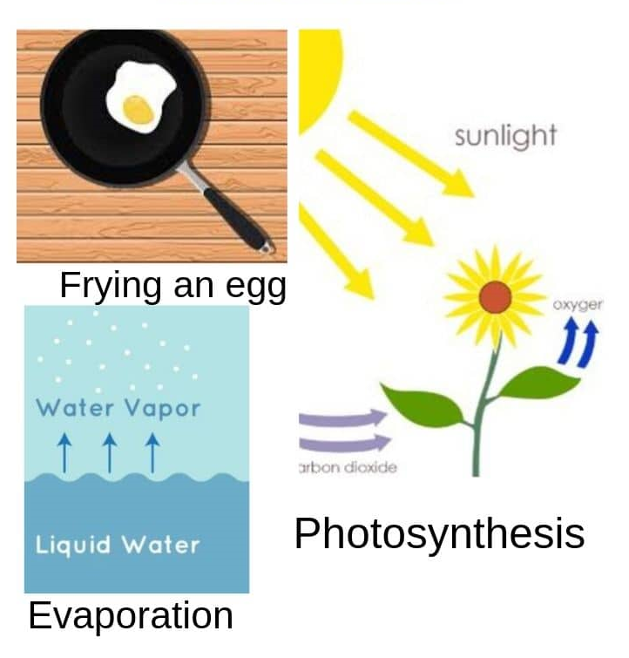
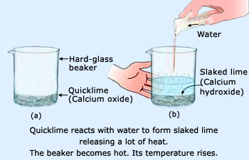
EXAMPLE OF EXOTHERMIC CHANGE AND ENDOTHERMIC CHANGE
ENDOTHERMIC
EXOTHERMIC

Slide 11
Thank you

